Slide 1
IoT Final Project Presentation
Djamankulov Alihan Mai Quang Vinh

Slide 2

Agenda
Project intro
Dashboard Look
Final look of breadboard (Wiring)
Project's phase:
Tasks & Role of each member
Materials
Challenges and achievements
Conclusion

Slide 3
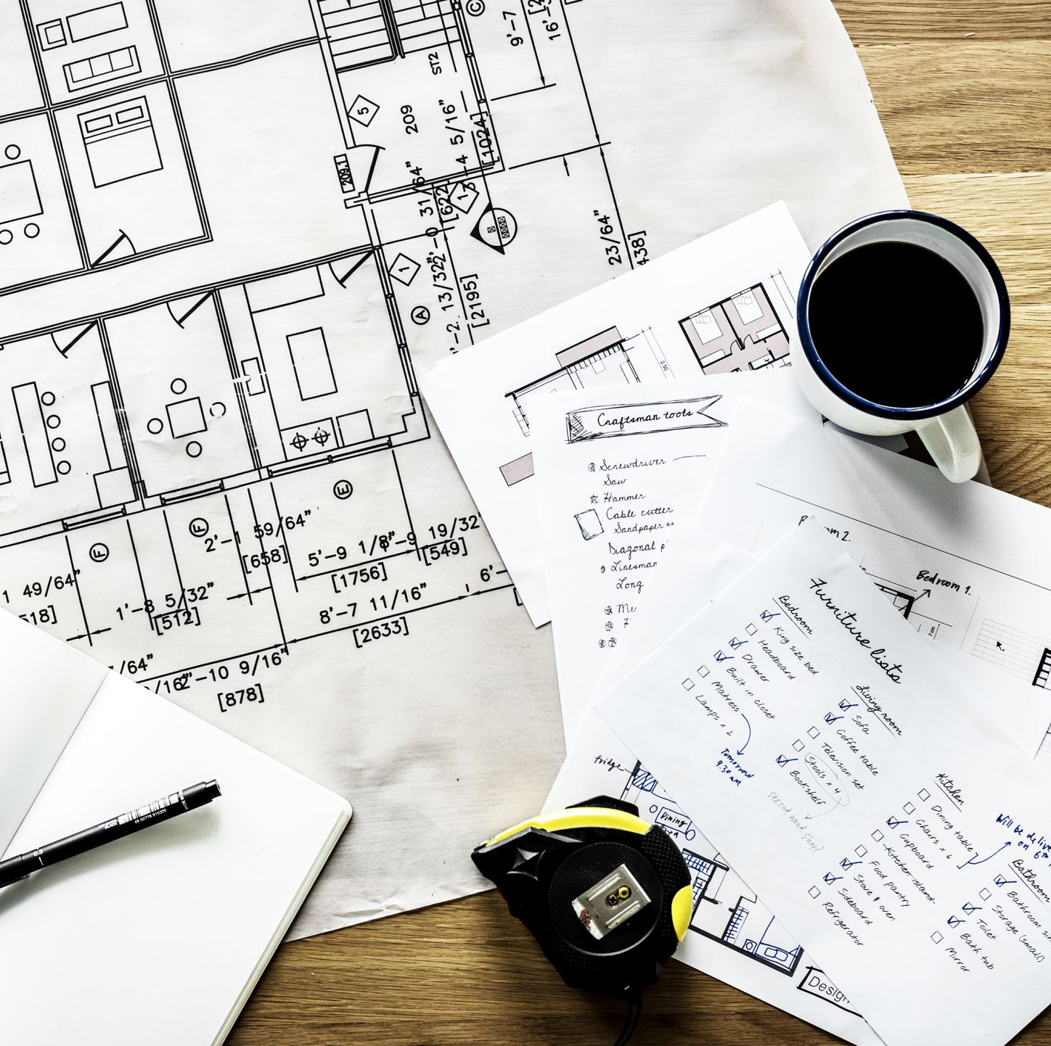
Project Introduction
The project's objective is to build an app/dashboard simulate a smart home system, where user can control physical device virtually.

Slide 4
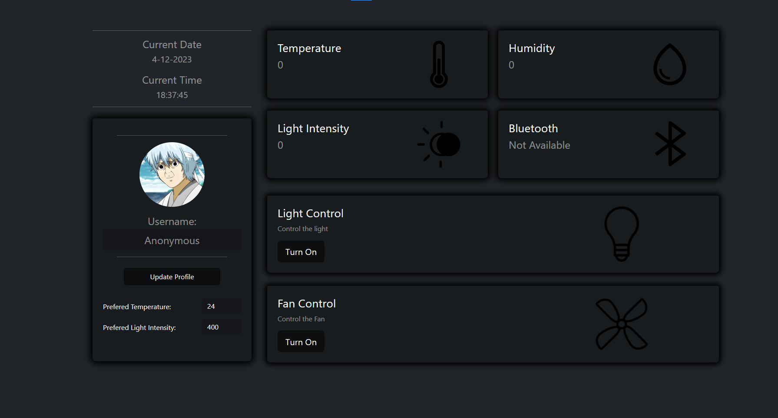
Our Dashboard
Dashboard

Slide 5
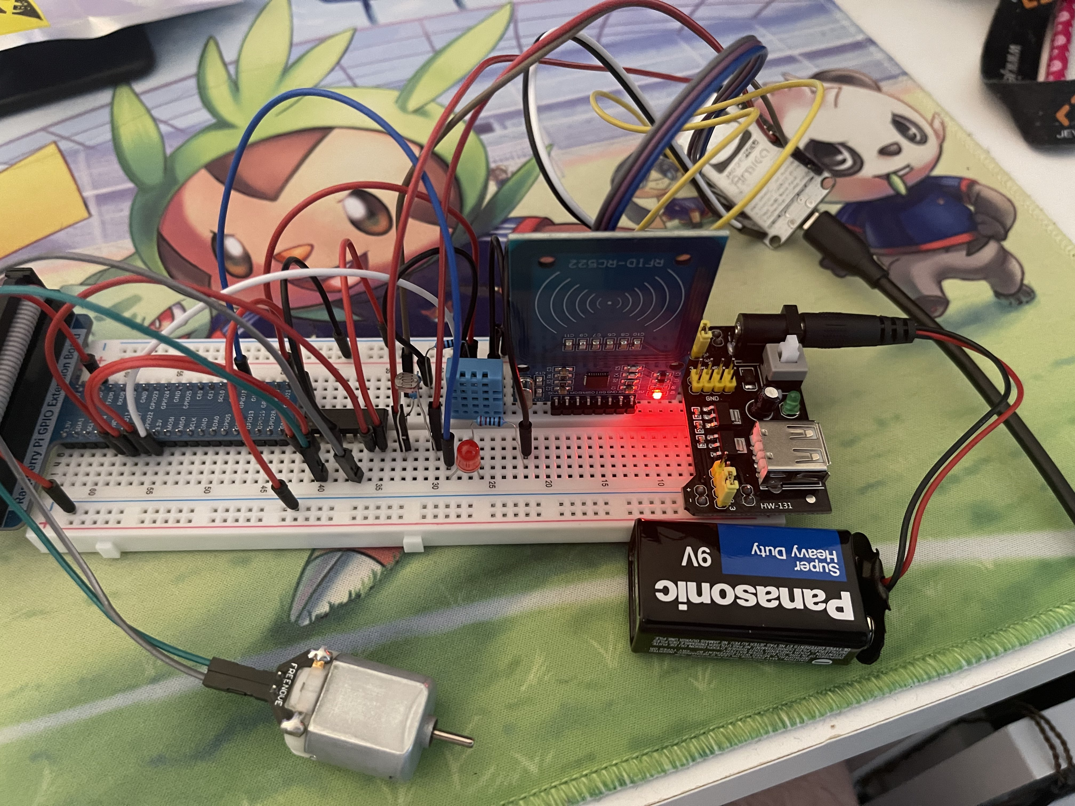
Wiring

Slide 6





Phase 1: Tasks & Role of each member
Vinh:
Experiment Dash and Flask and pick one
Implemented Flask based app
LED python code
JavaScript LED code
Dashboard UI
Debugging
Ali:
Helped with html and bootstrap for designing the app

Slide 7
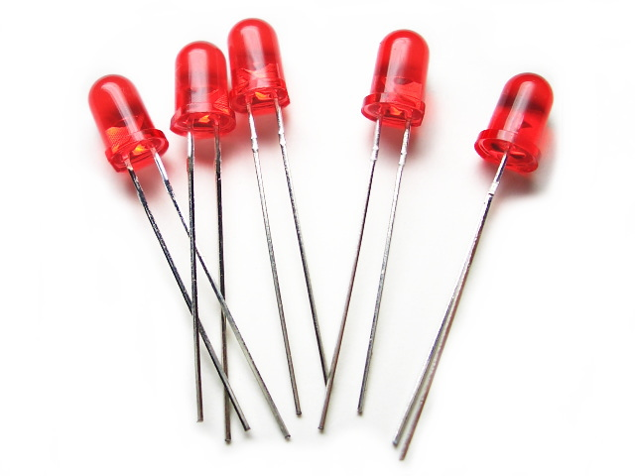
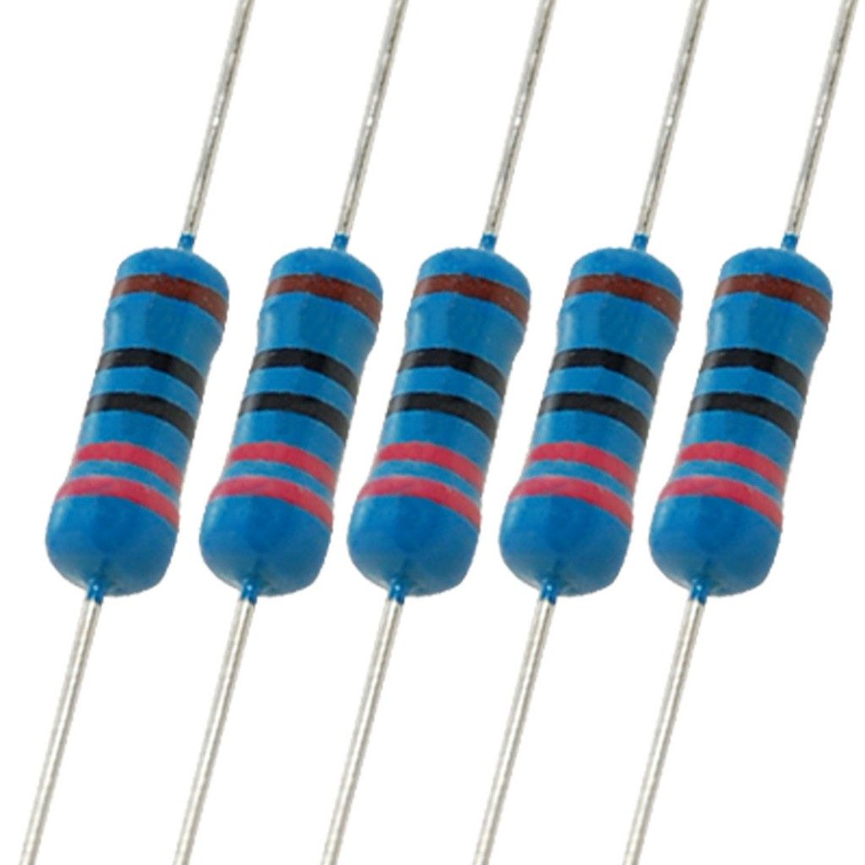
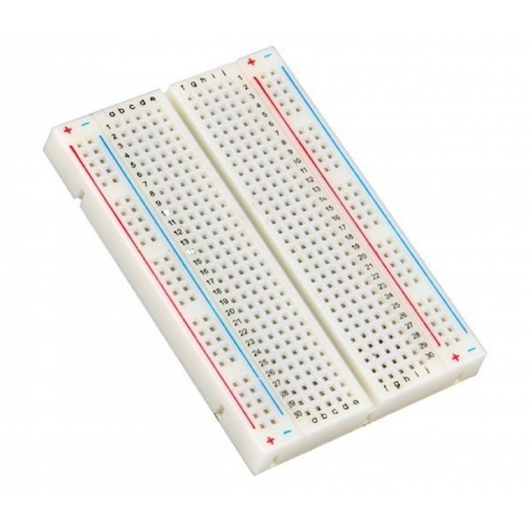
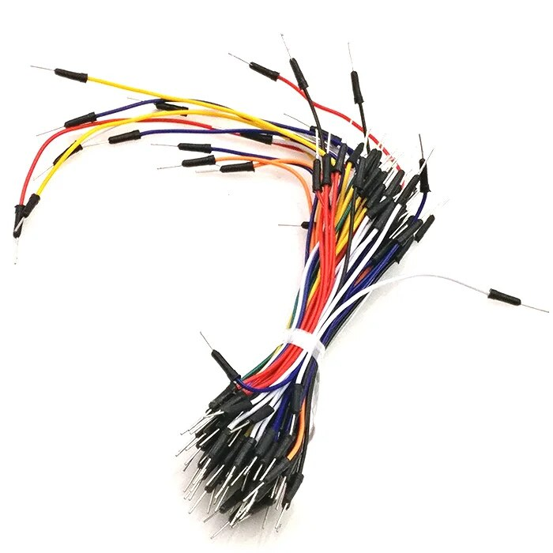
Phase 1: Materials
LED
Resistor 220
Wires
Breadboard
coder

Slide 8
Phase 1: Libraries
Time
RPi.GPIO
Flask

Slide 9
Phase 2: Tasks & Role of each member
Vinh:
Implement DHT11 to app to capture temperature & humidity
Implement Motor code to app
Implement get_data() in Python to give/return data in JSON
From JavaScript, request get_data() to Python every second
Update dashboard with new data gotten from Python
From JavaScript, check temperature and toggle fan/motor if exceed 24C
Add animation (CSS) to fans + lightbulbs + temperature & humidity indicator
Mailing
Read mail from inbox and turn on the fan accordingly based on the response of the user ("yes")
Debugging

Slide 10
Phase 2: Tasks & Role of each member
Ali:
Research about mailer package, stmp, imaplib protocol clients
Develop and set up mailing logic with mailer.py class
Develop send_mail route for sending messages to mail

Slide 11
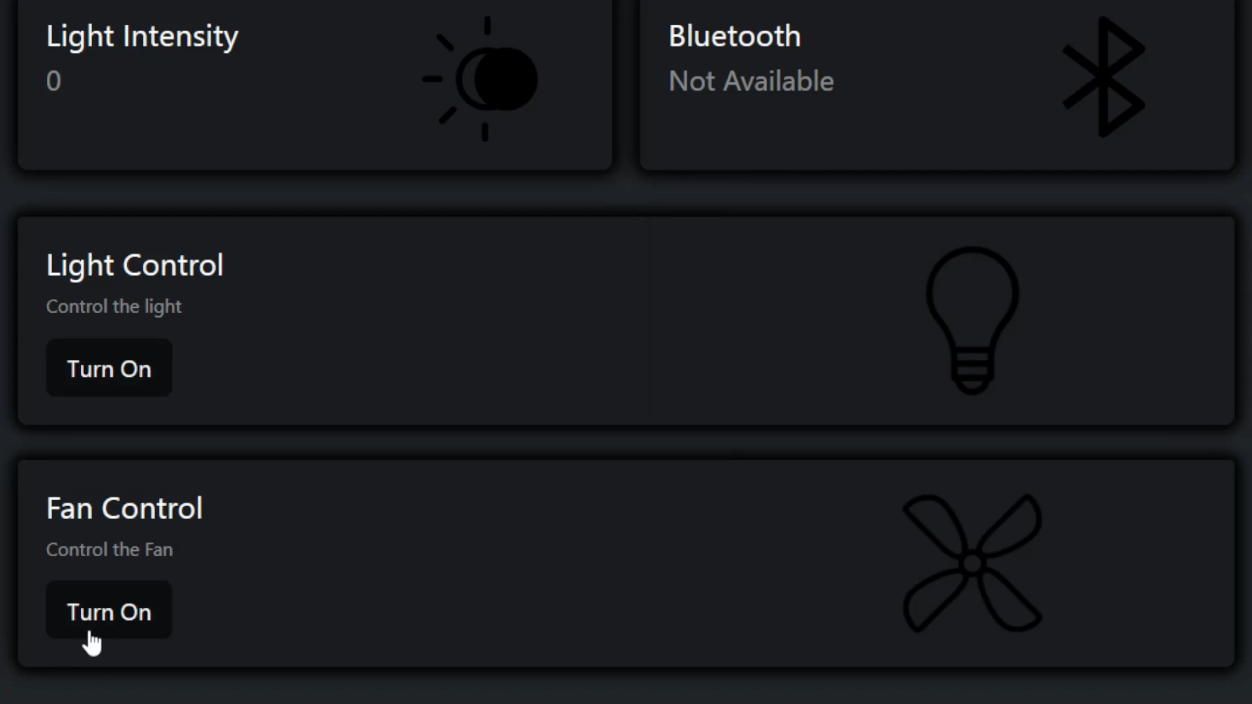
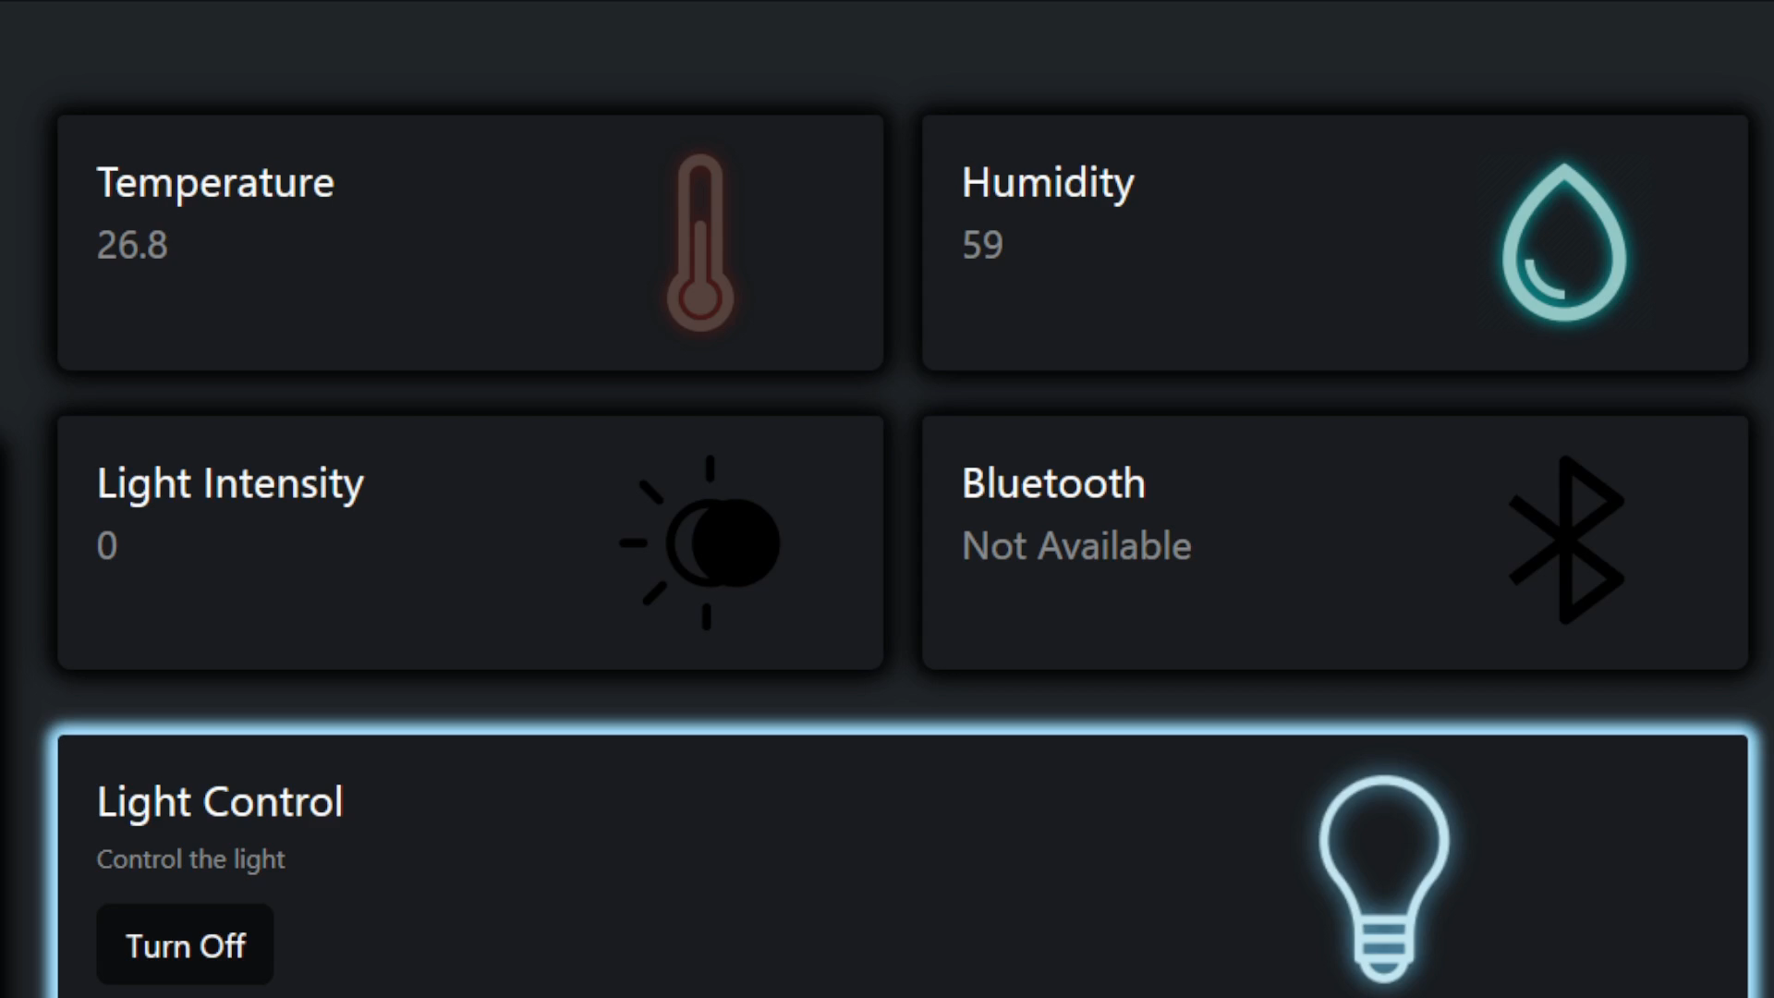
Phase 2: Tasks & Role of each member (cont.)

Slide 12
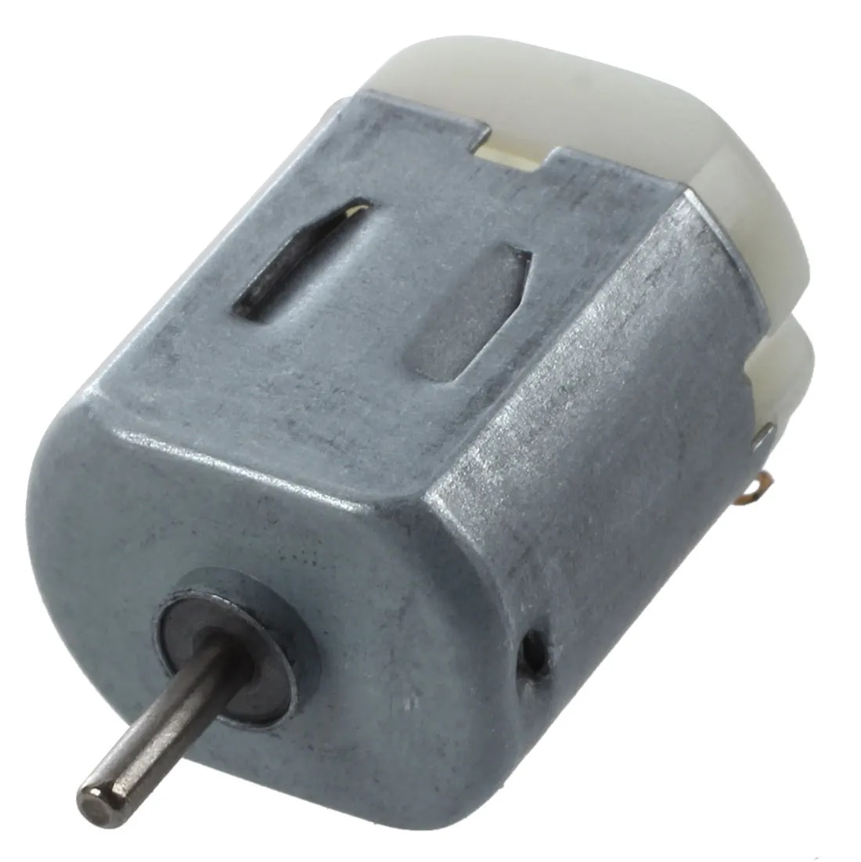
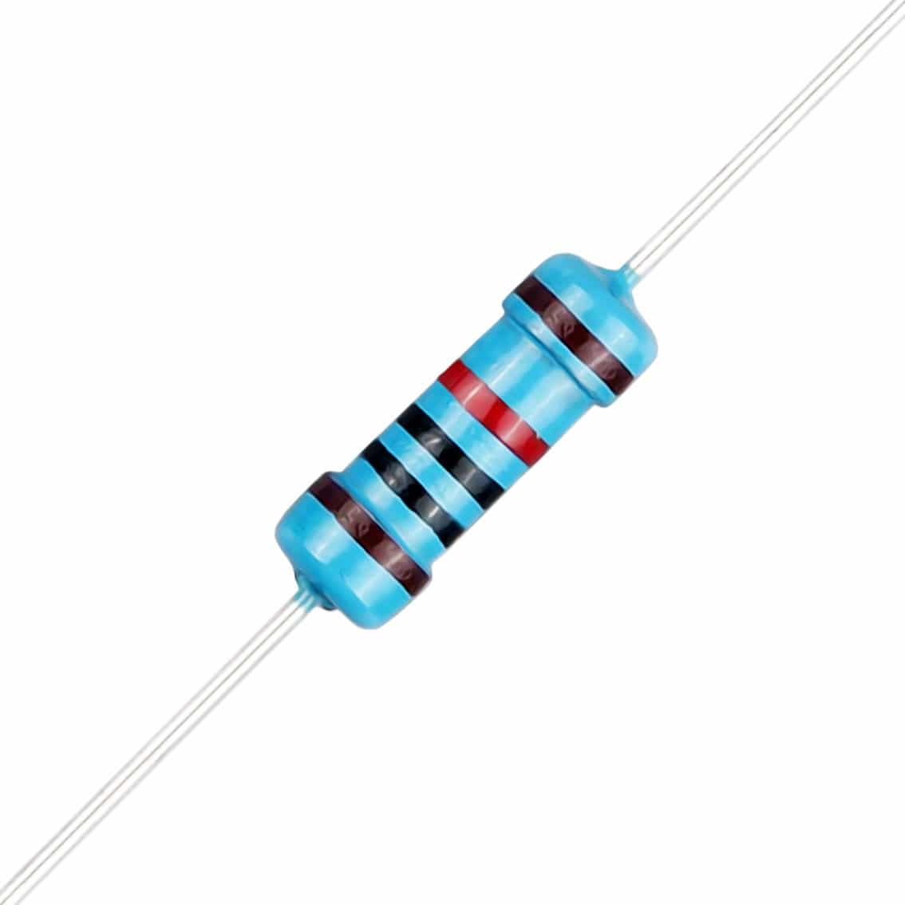
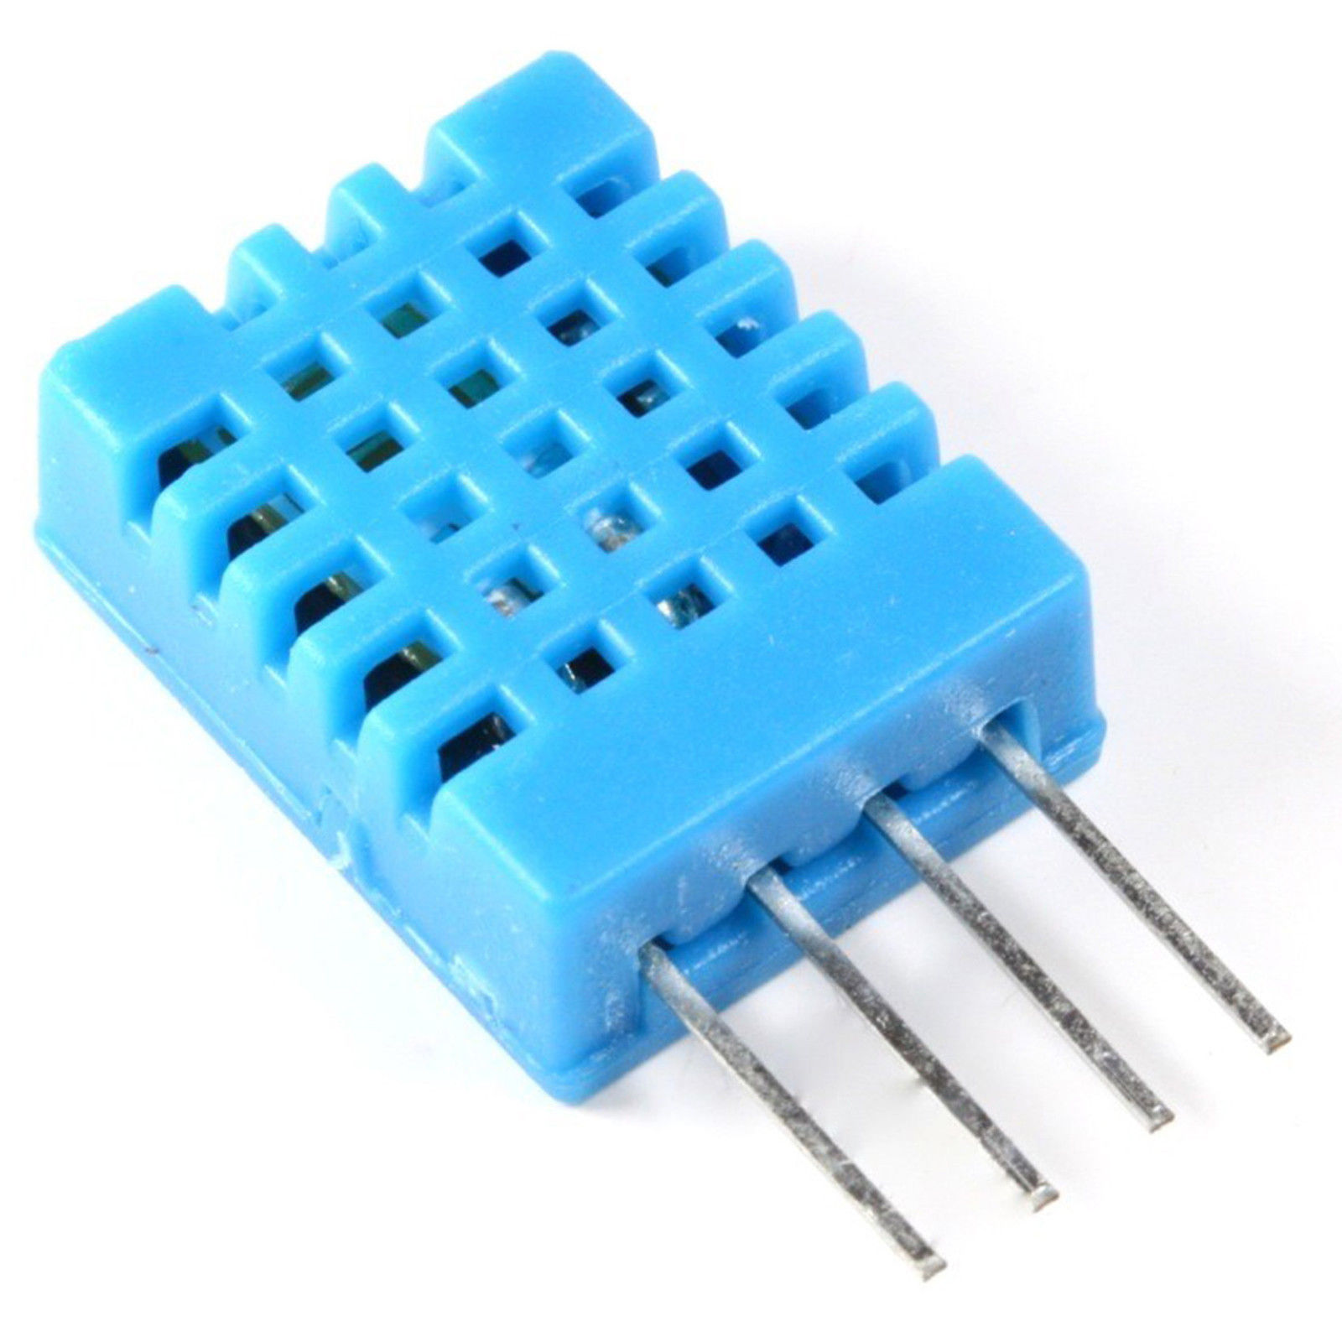
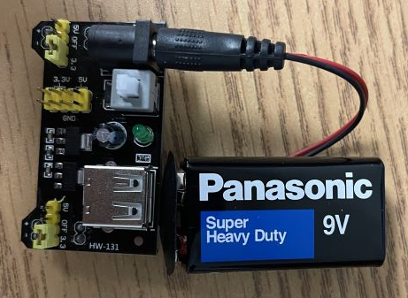
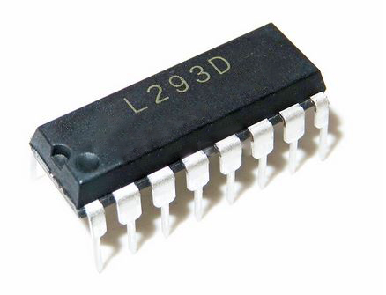
Phase 2: Materials
DHT11
Resistor 10k
DC motor
Micro motor controller
External power source + battery
coder

Slide 13
Phase 2: Libraries
Freenove_DHT
smtplib
imaplib
email
Json
mailer

Slide 14
Phase 3: Tasks & Role of each member
Vinh:
Implement ESP8266 to publish Light Intensity to server
Implement MQTT Server to app to subscribe
Update dashboard with new data gotten from Python
From JavaScript, check if Light Intensity > 400, toggle LED and the opposite
Implement animation (CSS) to Light Intensity Icon
Work on Database
Debugging

Slide 15
Phase 3: Tasks & Role of each member (cont.)
Alihan:
Researching about dynamic pop up notifications in js
From JavaScript, checks if Light Intensity > 400, then send mail "The light is ON at *** time"
Create alert function to pop notification on dashboard that the email was sent to the user

Slide 16
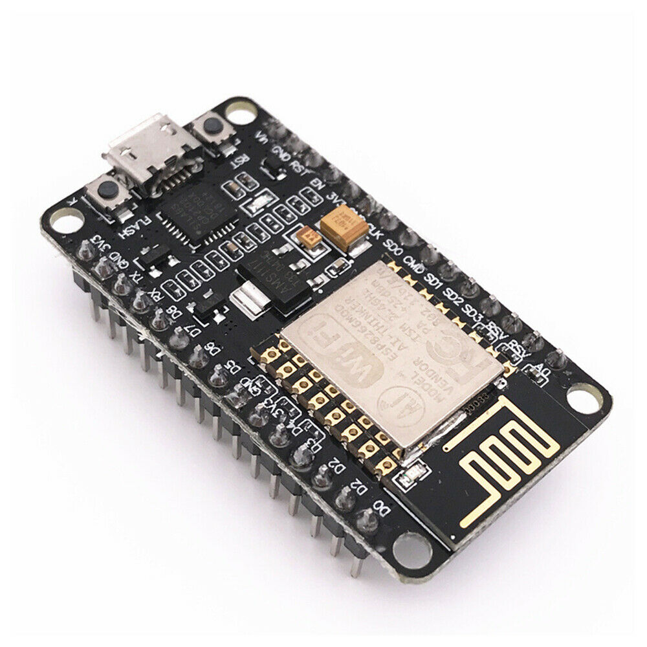
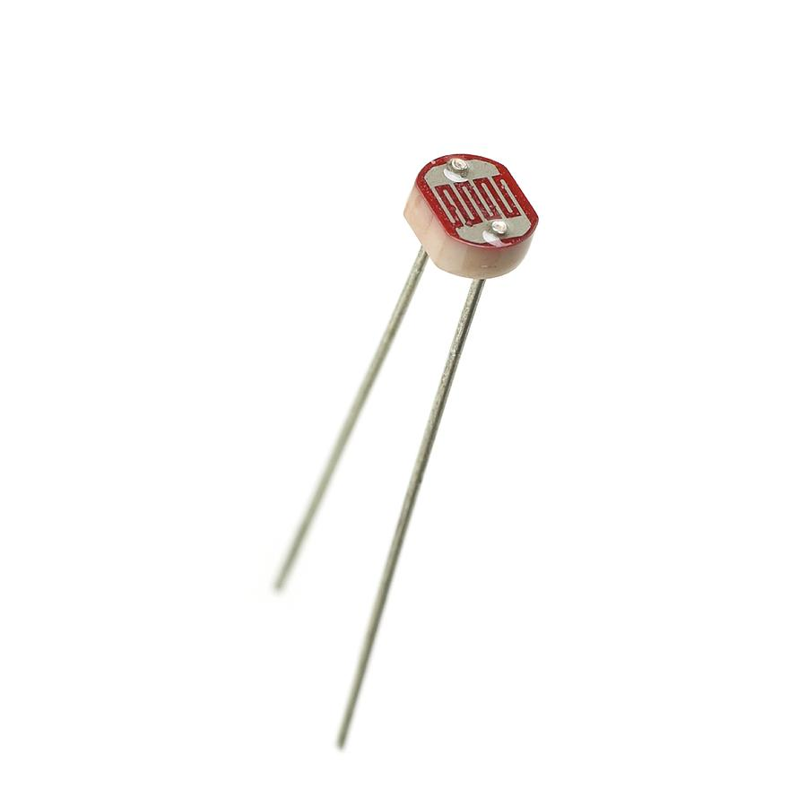
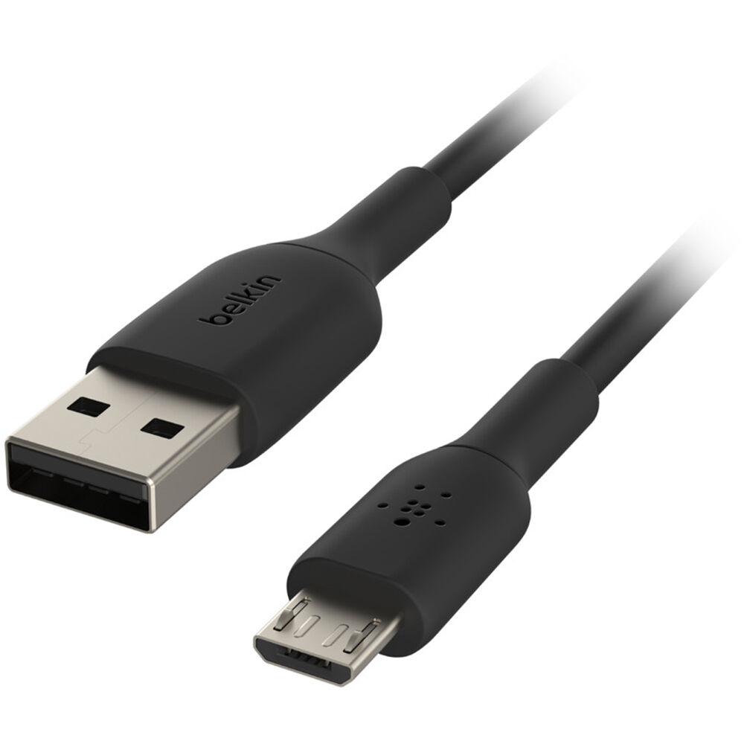

Phase 3: Materials
ESP8266
Resistor 220/10k
Photoresistor
Micro USB
Arduino IDE
coder

Slide 17
Phase 3: Libraries
paho.mqtt.client
threading
SQLite3
ESP8266WiFi.h
PubSubClient.h

Slide 18
Phase 4: Tasks & Role of each member
Vinh:
Rebuild/reconstruct/reorganise the dashboard UI
Implement SQLite3 to project, create database and way to communicate with database
Implement CRUD without D, allows creating new user, read/get user settings and update new setting
From JavaScript, apply new logged in user setting to the system (UI, …) and allow user to update their setting
Added "Current Date" + "Current Time" to dashboard
Clean up code, decrease latency and debugging

Slide 19
Phase 4: Tasks & Role of each member (cont.)
Alihan:
Implement RFID technology
Publish RFID and Subscribe on app to get RFID tag ID
Login with gotten tag ID, send email about logged in user
Update dashboard with new values of user favored settings

Slide 20
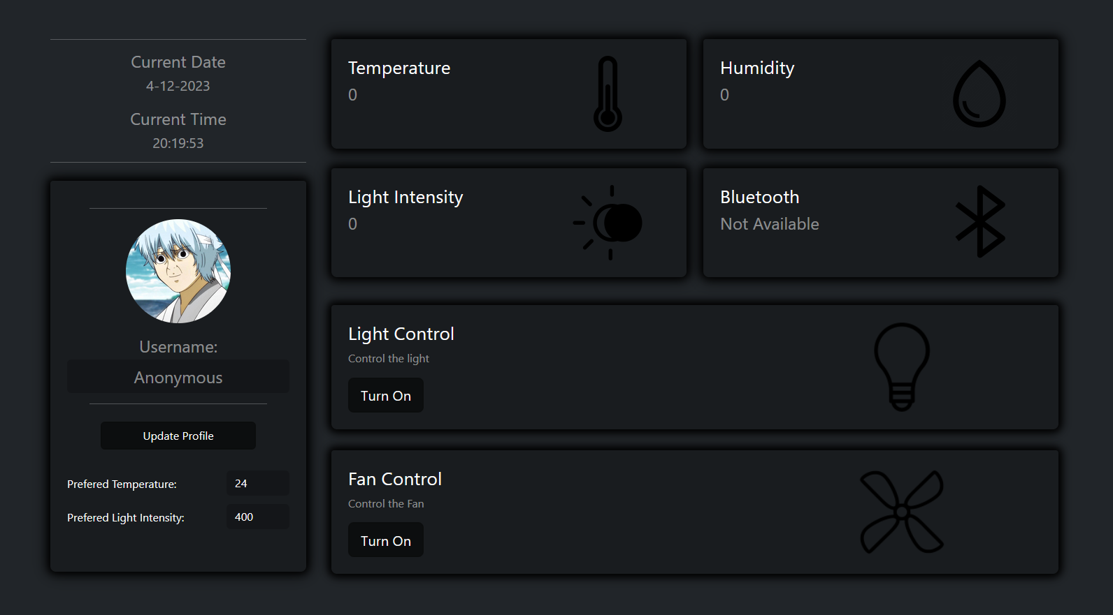
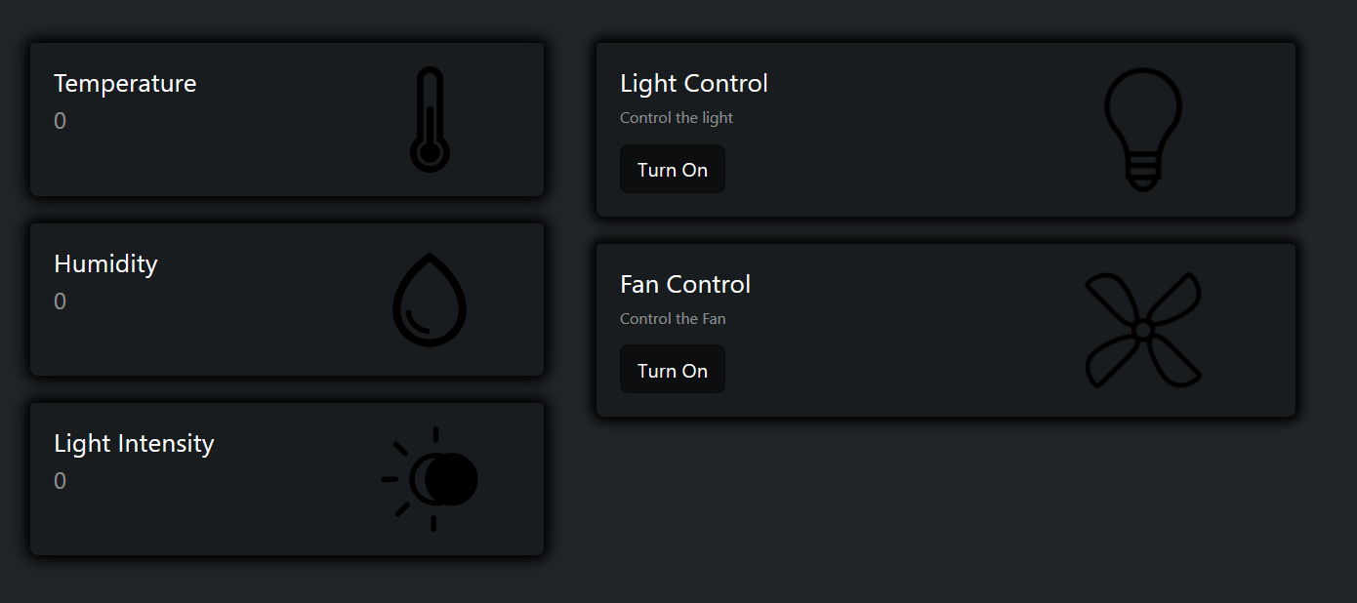
Phase 4: Tasks & Role of each member (cont.)

Slide 21
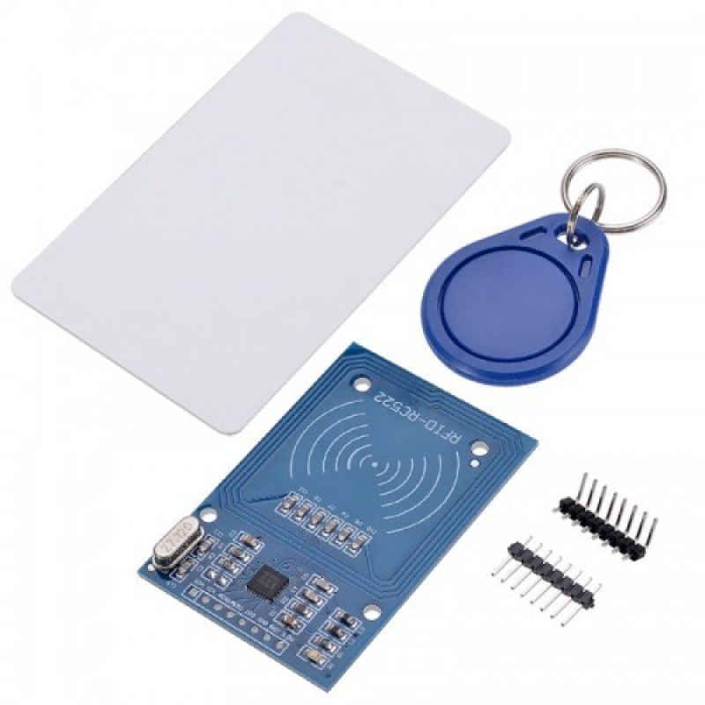
Phase 4: Materials
ESP8266 + Micro USB
Arduino IDE
RFID - RC522
Wires
Breadboard
coder

Slide 22
Phase 4: Libraries
paho.mqtt.client
Threading
SQLite3
datetime
ESP8266WiFi.h
PubSubClient.h
SPI.h
MFRC522.h

Slide 23
Challenges and achievements
Learn Bootstrap
The most challenging task was redesigning the dashboard
Learn Threading
Learn how to pass data from JavaScript to Python

Slide 24
Conclusion and improvements
The app was done on most of the task, except the Bluetooth even though it's a sub-task, still it's valuable for learning
Some improvement I would do more on is the design. It's very scuffed for now and irresponsive
A feature that could also be improved on is the profile picture features, allowing user to select their own loved avatar

Slide 25

Thank you for listening Any Question?

